Slide 1
Forecasting housing costs up to 2027
Evaluating historical and future housing prices in Minnesota, Wisconsin, Illinois, Indiana and Michigan

Slide 2
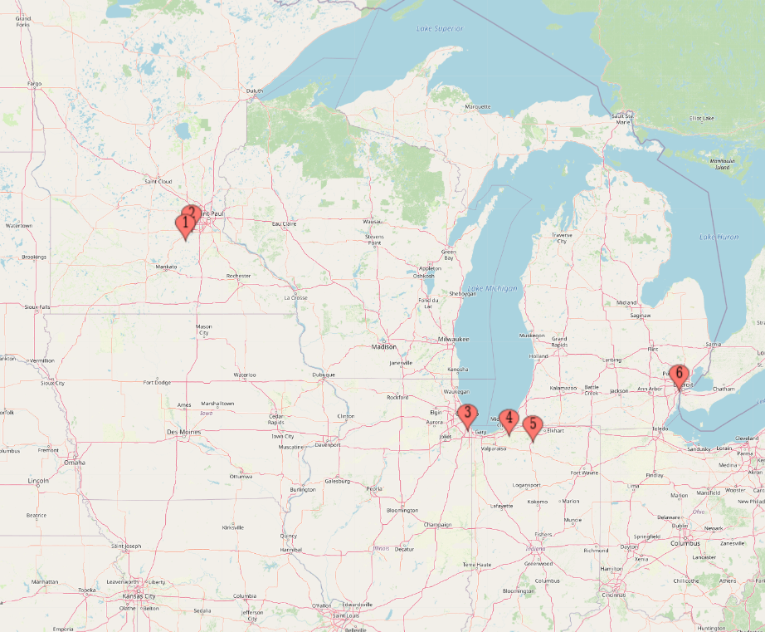
Understanding the Problem
My fiance and I will not be looking to purchase a house until 2026-27
We will be price conscious buyers
We have family distributed throughout several Midwest states

Slide 3

Data
Zillow - online real estate marketplace
Publishes a variety of data online - https://www.zillow.com/research/data/

Slide 4
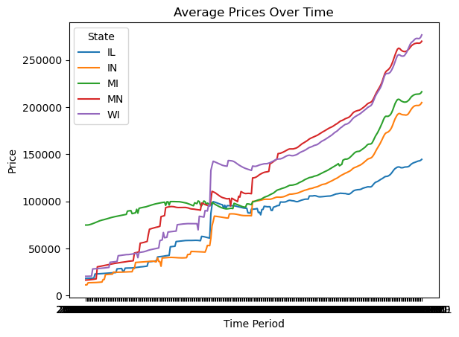
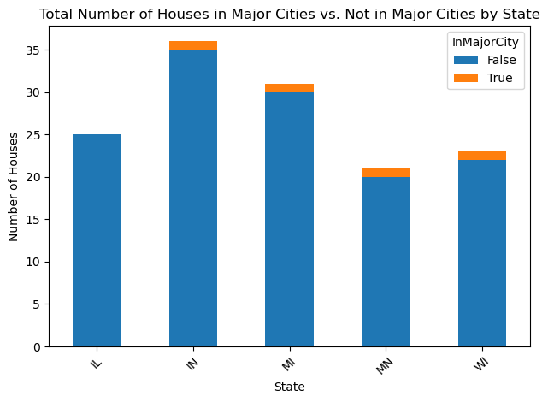
Exploratory Data Analysis
Surprising initial results

Slide 5
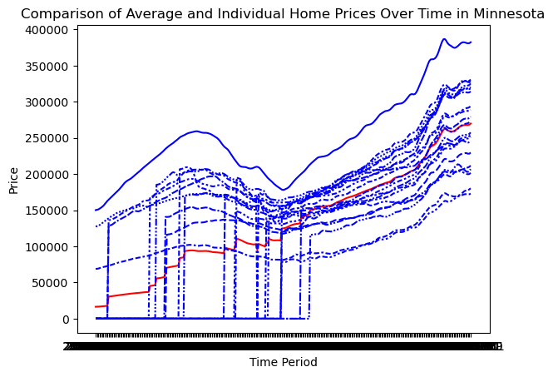
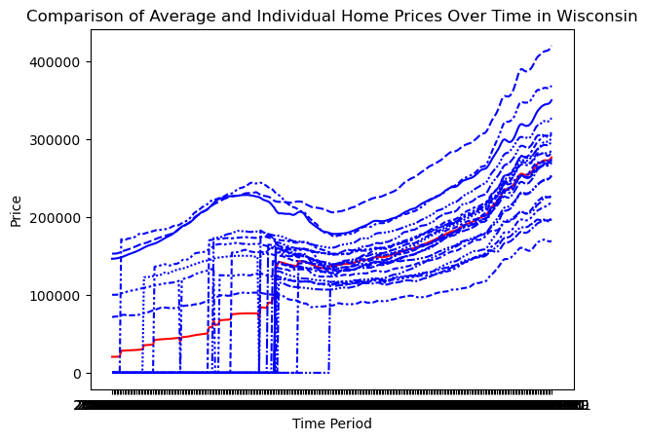
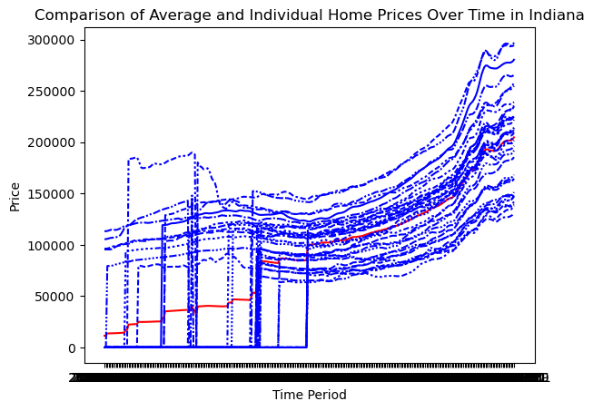
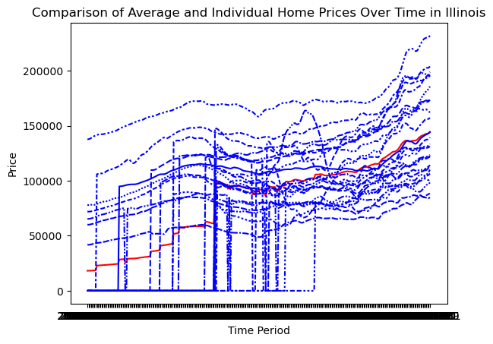
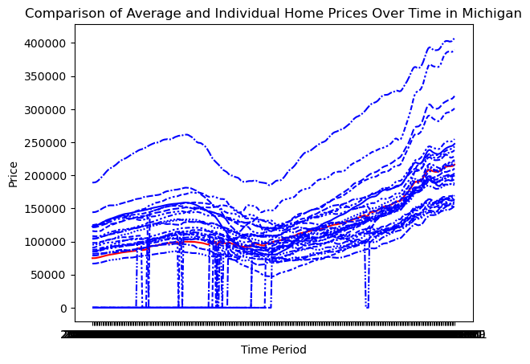
Exploratory Data Analysis - Cont’d

Slide 6
Notable Data Features
Illinois appears to be the cheapest state
There appear to be groupings of state values
Prices have been consistently increasing since 2012
There does not appear to be a “metro bias” in statewide pricing

Slide 7
Model Selection
Our data is already in scale
All relevant data is continuous, not categorical
Initial models considered included Linear Regression, Decision Tree Regressor, and Random Forest Regressor

Slide 8
Model Performance
Model metric will be RMSE
Linear Regression RMSE: 16,199.03
Random Forest Regressor RMSE: 21,472.71
Decision Tree Regressor RMSE: 23, 469.85
Unused Hyperparameter:
Linear Regression with fit_intercept set to False: 10,176.74

Slide 9
Modeling
Each state was separated into its own dataframe for modeling, removed state name information
Future dates from 4/2024 through 12/2027 were added for prediction, filled with NaN
Test split was not randomized - randomization does not make sense for time series data
After linear regression, results were recombined into a single dataframe

Slide 10
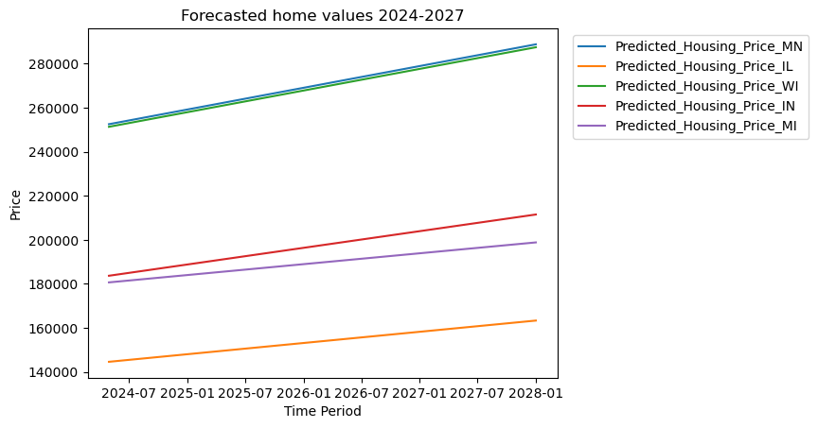
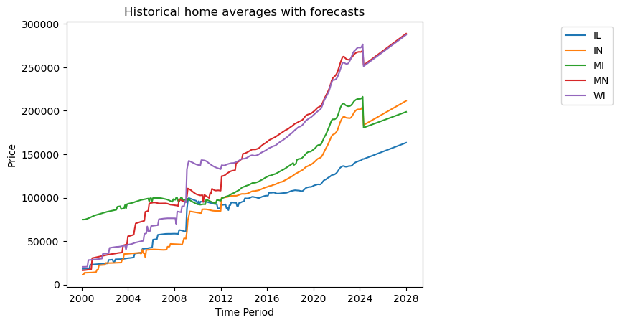
Results

Slide 11
Insights and Conclusion
Illinois will remain the least expensive state to purchase a home through 2027
States will continue the intriguing pattern of separating into segments, tied closely together in housing costs
Minnesota (our current home) and Wisconsin will continue at a near-identical pace to remain the most expensive states, and the gap will continue to widen

Slide 12
Future Research
It may be interesting and useful to research the following:
How well do housing costs correlate with the overall cost of living in a state?
Are there specific similarities between Minnesota/Wisconsin and Michigan/Indiana that have caused their home values to tie so closely together?
Given the housing costs we have forecasted, is it reasonable to believe first time home buyers are likely to leave Minnesota and Wisconsin for more affordable states?

